Slide 1
Passing of Time

Slide 2
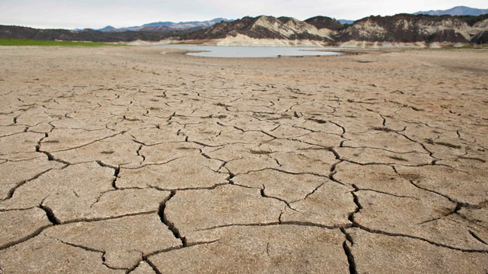

Slide 3
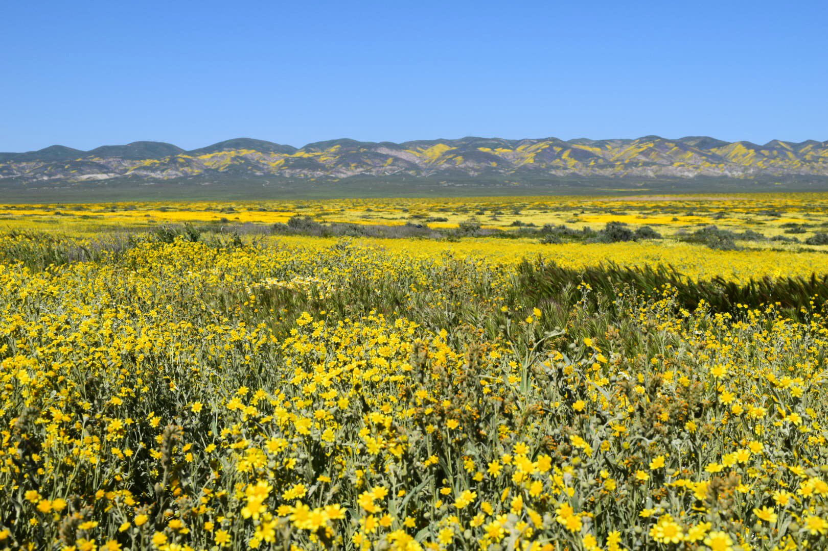

Slide 4
Quatrain
If you think your life is running out
There’s no doubt things are going to change
It’s like a prairie in the middle of the drought
Which can be followed by nothing but rain

